Slide 1
Artificial Intelligence and Machine Learning in Headache Medicine
Chia-Chun Chiang, MD
Alexander Mauskop, MD
New York Headache Center
Professor of Clinical Neurology
SUNY Health Sciences University
Julie Mauskop

Slide 2
Artificial Intelligence and Machine Learning in Headache Medicine
AI note-taking assistants may improve the quality and quantity of data collection and analysis
Adding health tracker data may provide additional info
AI models help diagnose different types of headaches with greater accuracy, even by non-specialists
Potential for AI to assist in underserved areas with limited access to specialists
If AI is better than a human, do we need to improve the education of humans? What role does human expertise still play in clinical medicine?
AI “hallucinations” - generation of incorrect or fabricated information

Slide 3
fMRI Insights into Migraine
Schwedt TJ, Chiang CC, Chong CD, Dodick DW. Functional MRI of migraine. Lancet Neurol. 2015
Key Findings:
Migraineurs exhibit atypical brain responses to sensory stimuli (visual, olfactory, painful cutaneous).
Lack of normal habituation to repetitive stimuli between migraine attacks.
Altered functional connectivity in sensory processing regions.
Severity of fMRI abnormalities correlates with headache frequency and longer migraine history.
Implications:
fMRI can identify neural dysfunctions leading to sensory hypersensitivities in migraine.
Potential to discover new targets for preventive therapies.
fMRI biomarkers may indicate early responses to preventive treatments.

Slide 4
Multimodal MRI-Based Diagnostic Model for Migraine
Namgung JY, et al. A robust multimodal brain MRI-based diagnostic model for migraine: validation across different migraine phases and longitudinal follow-up data. J Headache Pain. 2025;26(1):5.
Morphological features: cortical thickness, curvature, and sulcal depth, and functional connectivity features, such as low-dimensional representation of functional connectivity (gradient), degree centrality, and betweenness centrality
Performance Metrics: Accuracy: 87%, Area Under Curve (AUC): 0.94
Validation Across Migraine Phases:
Interictal (between attacks): Accuracy: 85%, AUC: 0.97
Ictal/Peri-ictal (during/around attacks): Accuracy: 84%, AUC: 0.93
Longitudinal Validation (1-year follow-up): Overall Accuracy: 91%, AUC: 0.96
Implications: Demonstrates the potential of combining multimodal MRI features with machine learning for robust migraine diagnosis.
Notes:
Anything else we could show to support economic benefit of Imitrex or 100 mg?
Every minute the cost to employers.
Cost to have one of their assistants out with migraine for a year.
Delete here - since moved to # 36 - what do you think ?

Slide 5
Insular Connectivity Differentiates Posttraumatic Headache in mTBI Patients
Li F, et al. Connectivity of the insular subdivisions differentiates posttraumatic headache-associated from nonheadache-associated mild traumatic brain injury: an arterial spin labelling study. J Headache Pain. 2024;25(1):103.
94 mTBI patients underwent arterial spin labeling (ASL) perfusion MRI
Compared FC between insular subregions and other brain regions in mTBI patients with PTH (mTBI + PTH) and without PTH (mTBI - PTH)
Changes in the perfusion-based FC of the left posterior insula/dorsal anterior insula with the thalamus/MCC were significantly correlated with headache characteristics.
Notes:
Anything else we could show to support economic benefit of Imitrex or 100 mg?
Every minute the cost to employers.
Cost to have one of their assistants out with migraine for a year.
Delete here - since moved to # 36 - what do you think ?

Slide 6
fMRI data in migraine
Aberrant cerebral blood flow and functional connectivity in patients with vestibular migraine: a resting-state ASL and fMRI study. Chen Z, et al. The Journal of Headache and Pain 2024; 25:84
Compared with HC, VM patients showed:
increased FC between the right PreCG and areas of the left PostCG left cuneus and right lingual gyrus
decreased FC between the left insular and regions of the left thalamus and right anterior cingulate cortex
increased FC between the left insular and right fusiform gyrus
These variations in brain perfusion and FC were significantly correlated with frequency of migraine symptoms, frequency of vestibular symptoms and disease duration of VM

Slide 7
fMRI data in migraine

Slide 8
rTMS for migraines
Efficacy of repetitive transcranial magnetic stimulation on chronic migraine: A meta-analysis. Zhong J, et al. Front Neurol 2022; 13: 1050090.
Eight studies
rTMS was more effective for decreasing migraine attacks than the sham rTMS. Effect size of −1.13 on the frequency of migraine attacks
The meta-analysis revealed that rTMS is an effective approach for reducing migraine attack when the dorsolateral prefrontal cortex was stimulated. However, rTMS did not reduce the pain level

Slide 9
rTMS for migraines
Safiai NIM, et al. High-frequency repetitive transcranial magnetic stimulation at dorsolateral prefrontal cortex for migraine prevention: A systematic review and meta-analysis. Cephalalgia. 2022;42(10):1071-1085
Meta-analysis revealed that high-frequency repetitive transcranial magnetic stimulation over dorsolateral prefrontal cortex significantly reduced acute medication intake and functional disability
However, no differences were found in headache days and pain intensity reduction, although there was a slight trend favoring high-frequency repetitive transcranial magnetic stimulation

Slide 10
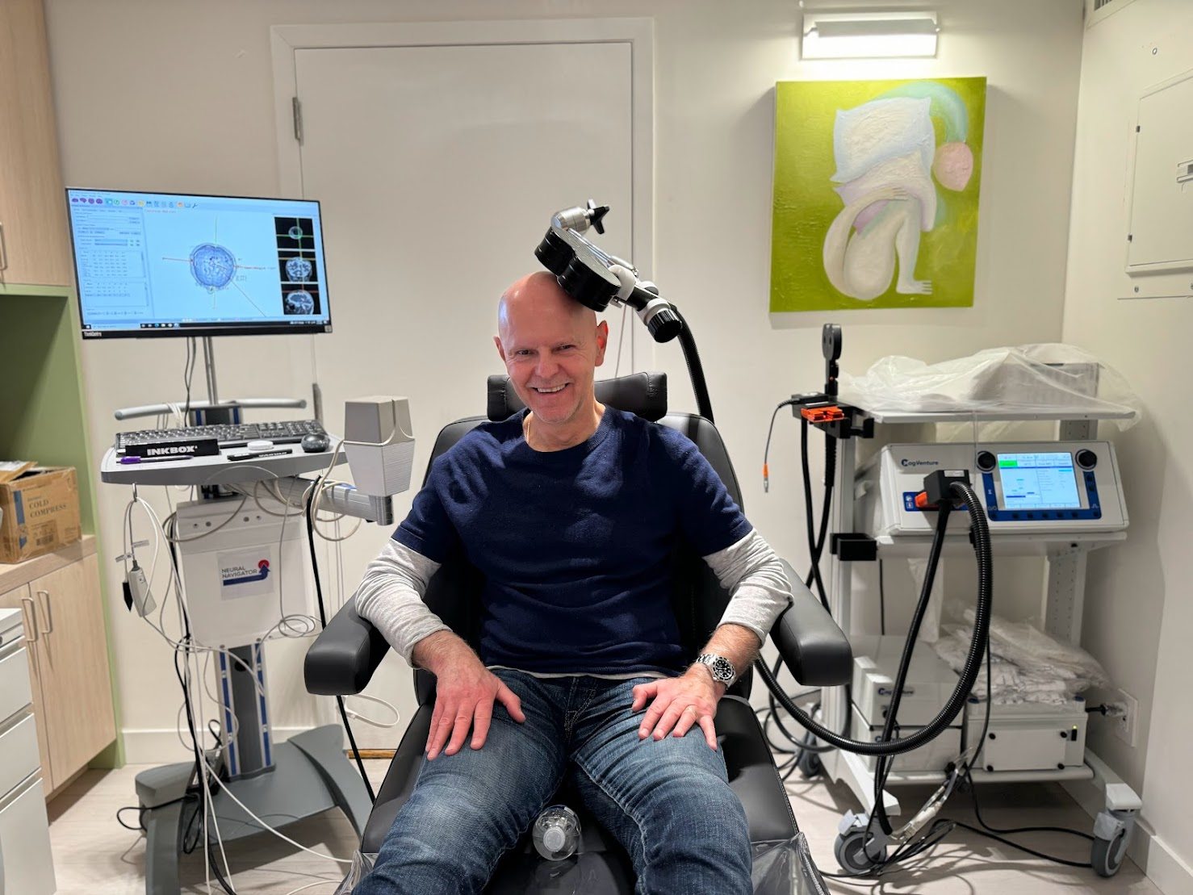
rTMS for migraines
Photo of our setup

Slide 11
AI in migraine
The future is bright!
Better diagnosis, treatment selection, drug development, individualized neuromodulation, and disease prevention through:
Machine learning based on clinical data
Structural and functional imaging
Omics – genomics, epigenomics, connectomics, proteinomics, metabolomics, etc
AI-aided traditional drug development – faster target identification, design of drugs, virtual drug screening, efficacy and toxicity prediction, etc

